Slide 1
Introduction to Optimization
CBMM Summer School
Aug 12, 2018

Slide 2

What you will learn
What optimization is used for
Different optimization concepts
Commonly used terminology, marked with:
In the notes: pointers to how to perform optimization in common programming languages (R, Python, Matlab)

Slide 3
Materials and notes
http://bit.do/IntroOptim

Slide 4
Important terms
Likelihood
Maximum likelihood estimate
Cost function
Gradient
Gradient descent
Global / local minima
Convex / non-convex functions
Differentiable functions
Stochastic gradient descent
Regularization
Sparse coding
Momentum

Slide 5
Agenda
Likelihood and cost functions
Single variable optimization
Multi-variable optimization
Optimization for machine learning
Stochastic gradient descent
Regularization
Sparse coding
Momentum

Slide 6
Likelihood & Cost Functions

Slide 7
What is the likelihood?
Likelihood: The probability of observing your data given a particular model
A set of data
A model and its associated parameterization

Slide 8
Example: Balls in urns
Suppose we have an urn with white and black balls, but we don’t know the proportion. We pull some with replacement and get:
BBWBWWBWWWBW
What is the probability of getting this sequence if the balls were equally distributed – P(Black) = 0.5?
What is the probability of getting this sequence if the urn was 75% filled with black balls?

Slide 9
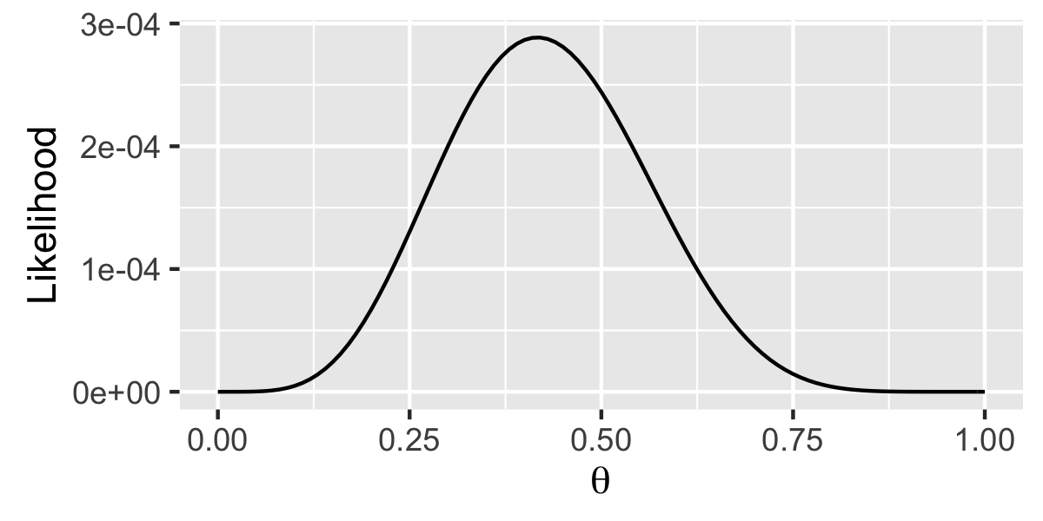
Example: Balls in urns
Suppose we have an urn with white and black balls, but we don’t know the proportion. We pull some with replacement and get:
BBWBWWBWWWBW
We can abstract this function and view it for any (allowed) value of the probability (θ):
What does this tell us about the urn?
Notes:
Note: likelihood is not a probability function – does not integrate to 1
Transition: We know the model, we know the data; we want to determine what parameterization of the bias makes the data most likely

Slide 10
Maximum likelihood estimator
Maximum Likelihood Estimator: The value of the parameters of a given model that maximizes the likelihood function for a set of data

Slide 11
Example: Coin flips
Suppose we have an urn with white and black balls, but we don’t know the proportion. We pull some with replacement and get:
BBWBWWBWWWBW
Θ_{mle}= 5/12
How do we find this value more generally?
Notes:
Note: likelihood is not a probability function – does not integrate to 1
Transition: We know the model, we know the data; we want to determine what parameterization of the bias makes the data most likely

Slide 12
Cost functions
Cost function / loss function: A function that maps a set of events into a number that represents the “cost” of that event occurring
More general than likelihood
The “cost” of likelihood is typically the negative log-likelihood:

Slide 13
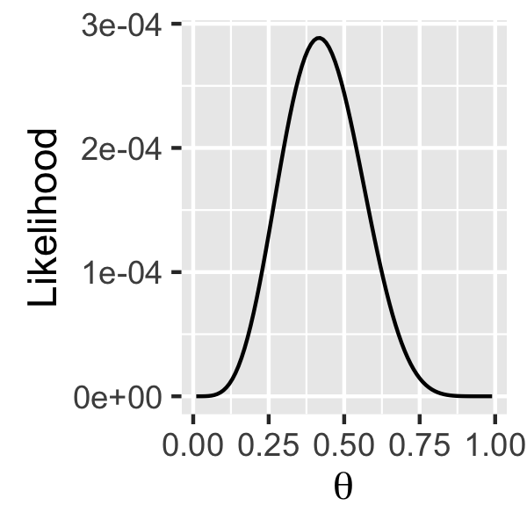
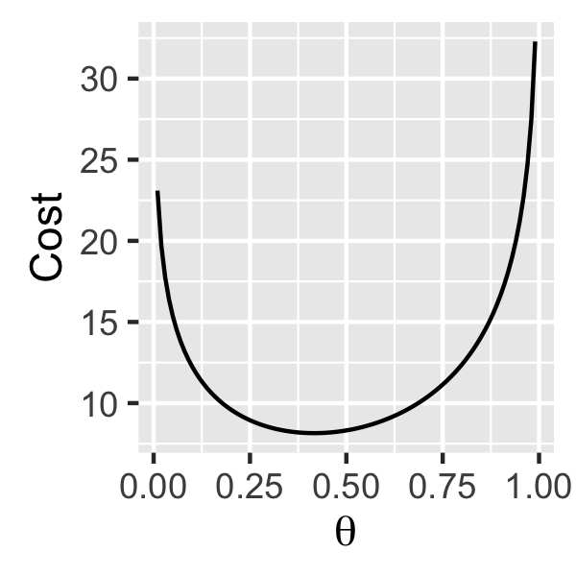
Likelihood -> Cost

Slide 14
Single-Variable Optimization

Slide 15
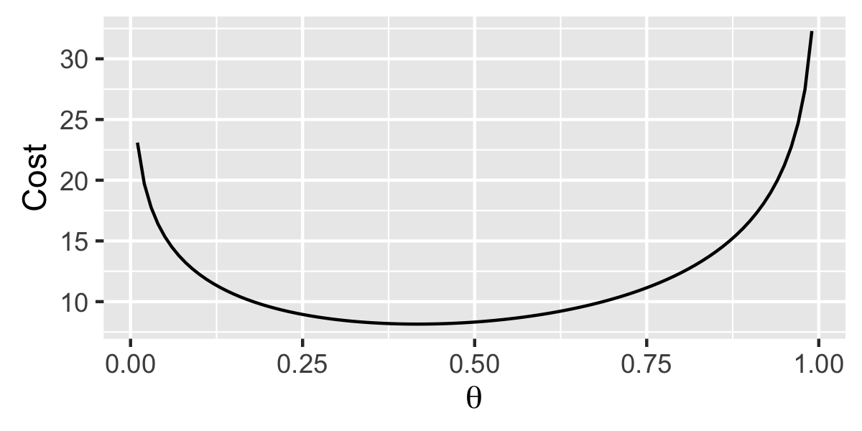
Back to the urn problem…
Suppose we have an urn with white and black balls, but we don’t know the proportion. We pull some with replacement and get:
BBWBWWBWWWBW
How do we find this value more generally?

Slide 16
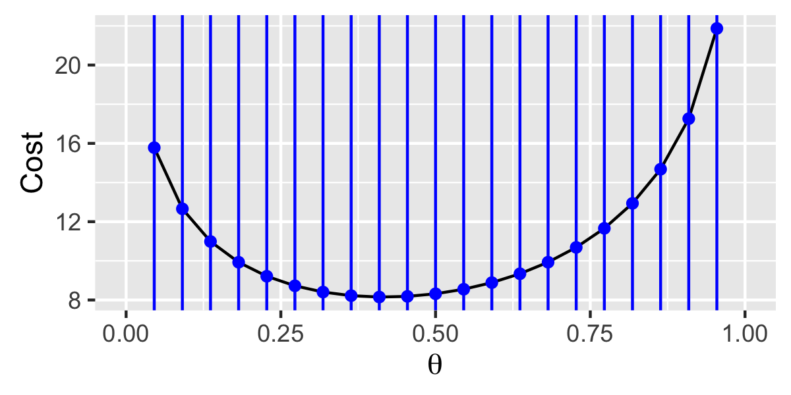
Grid search (brute force)
Here’s the minimum!

Slide 17
Grid search (brute force)
Pros:
Guaranteed to get you close to the minimum (with fine enough grid)
Easy to implement
Cons:
Inefficient
Only really works for 1-2 parameters

Slide 18

Gradient descent
Fog
You
Camp

Slide 19
Gradient descent
This way is downhill
This way is downhill

Slide 20
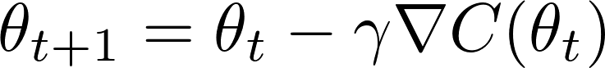
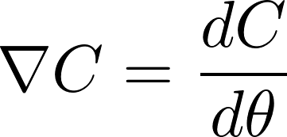
Gradient descent
Gradient descent: An optimization technique where parameters are updated proportionally to the negative gradient to continually step “downhill” in the cost function
Step-size parameter

Slide 21
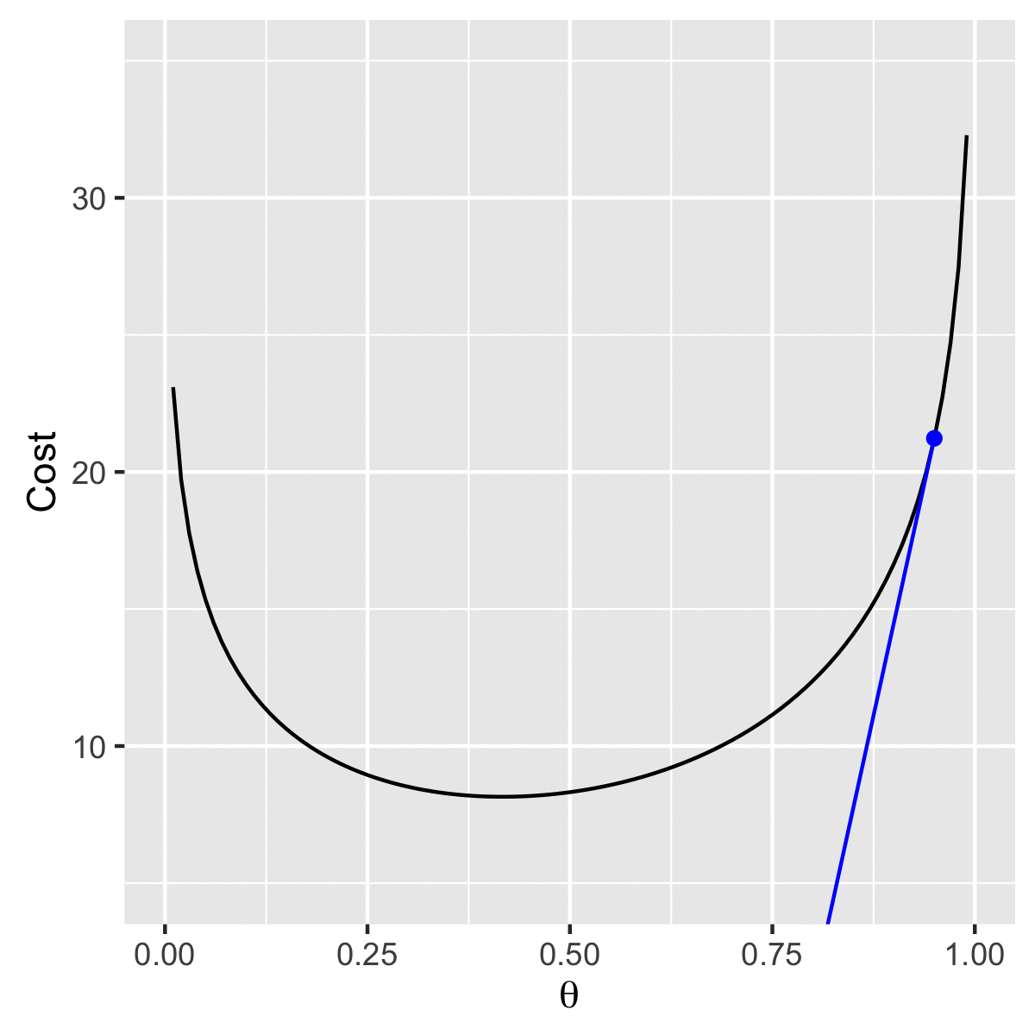
Gradient descent

Slide 22
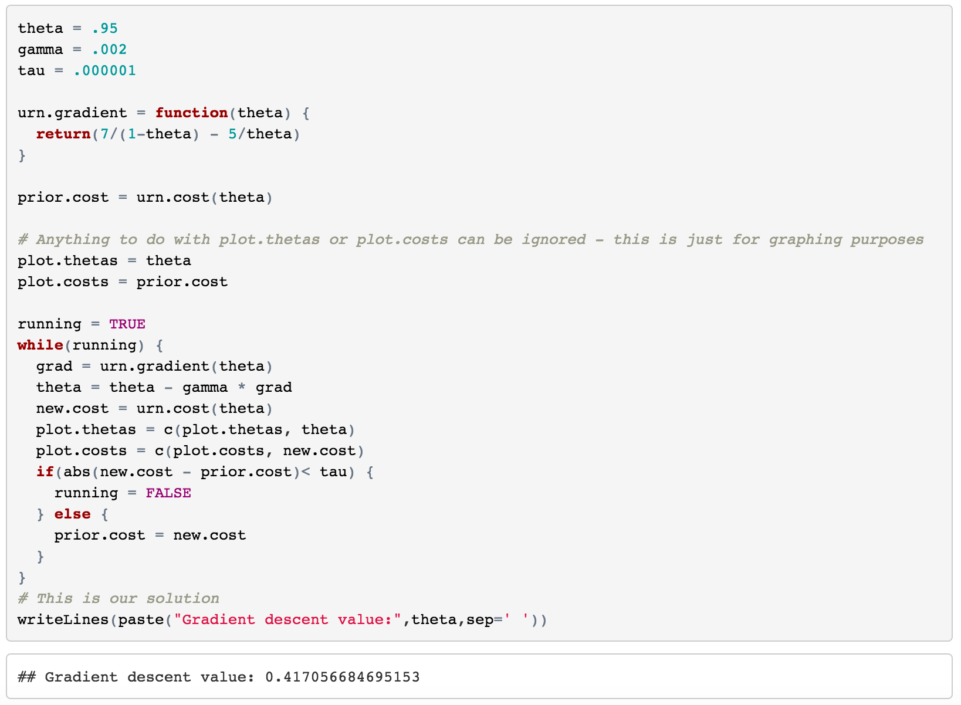
Gradient descent
But we had to calculate the gradient!
≈ 5 / 12

Slide 23
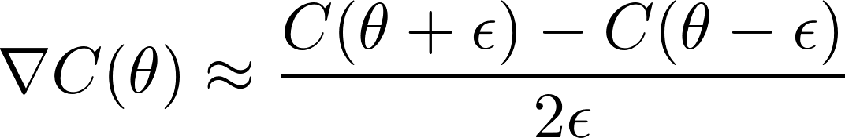
Gradient descent
But what if we don’t know how to calculate the gradient?
… We approximate it!

Slide 24
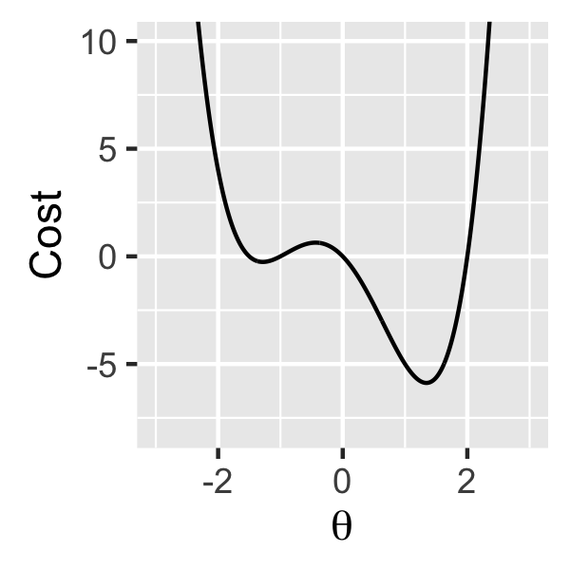
Local vs. global minima
Global Minimum
Local Minimum
θ = -1.294

Slide 25
Local vs. global minima
Local minimum: a point x∗ is a local minimum if it is the lowest value of the function within some range centered on x∗
Global minimum: a point x∗ is a global minimum if it is the lowest value of the function across all allowable values of the parameter

Slide 26
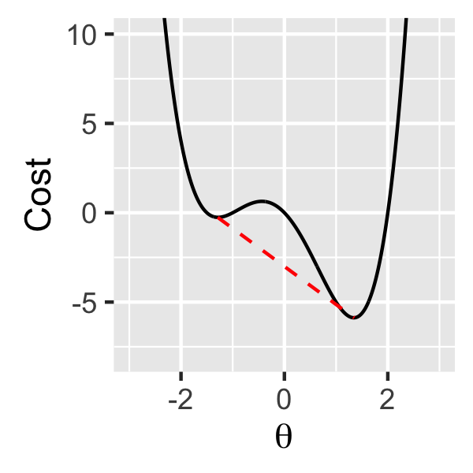
Convex vs. non-convex functions
Convex function: A function is convex if for every line segment drawn between two points on the function, that line segment passes above the graph
Non-convex function: A function that is not convex
A minimum on a convex function is guaranteed to be a global minimum!

Slide 27
Implementation
Language | Single-var
R | optimize
Python* | minimize_scalar
Matlab | fmindbnd
*: Python optimization functions require the “scipy” package
The implementations of optimization use more advanced algorithms than discussed here. See the notes for further details!

Slide 28
Multi-Variable Optimization

Slide 29
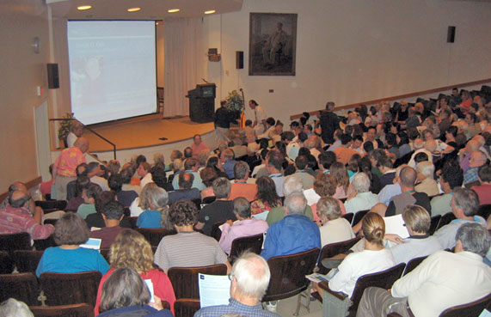



Lecture attendance problem

Slide 30
Lecture attendance problem
Working
Hung-over
P(Skip | Work) = ?
Skipping
P(Skip | Hung-over) = ?

Slide 31



Lecture attendance problem
Working
Hung-over
Skipping
✔
✖
✖
✔
✔
✖
✖
✖
✖
✖
✔
✔

Slide 32
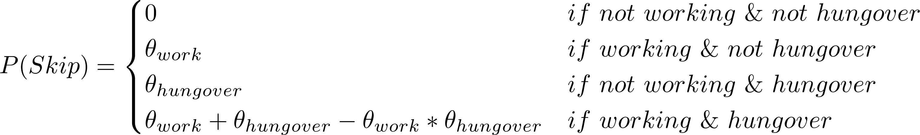
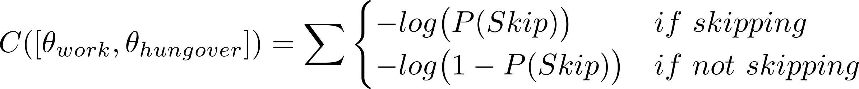
Lecture attendance problem
Attending
Skipping
 | HungO | ~HungO
Work | 42 | 17
~Work | 57 | 26
 | HungO | ~HungO
Work | 0 | 10
~Work | 18 | 30

Slide 33
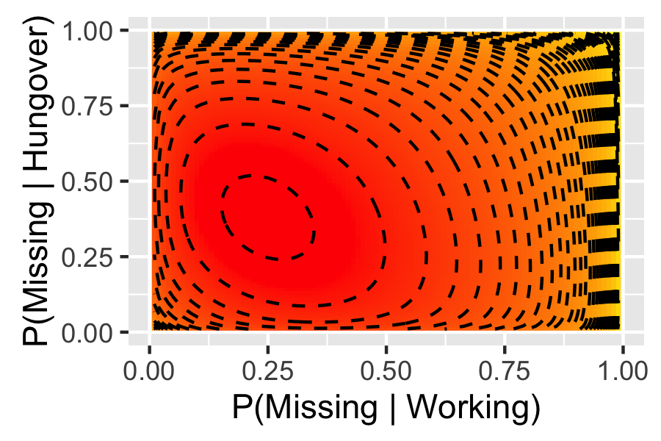
Lecture attendance problem

Slide 34
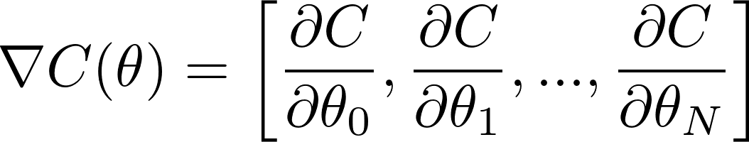
Multi-dimensional gradients
Almost the same as single-dimensional, but as a vector to represent both the magnitude and direction:

Slide 35
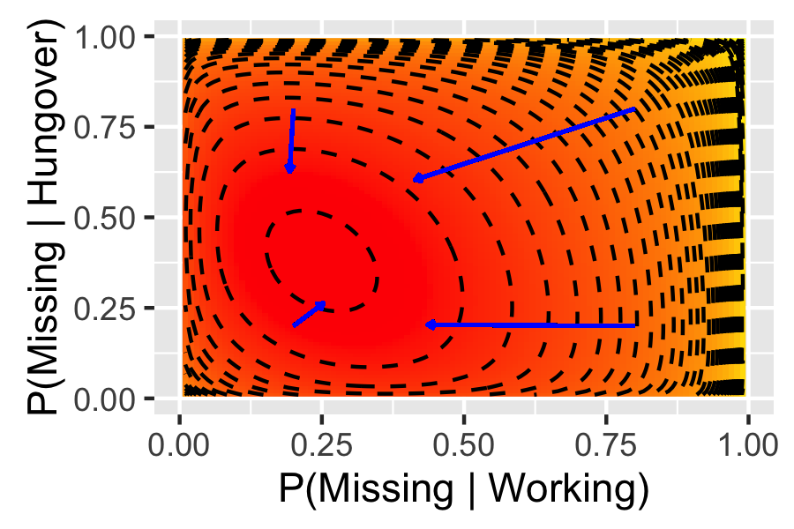
Multi-dimensional gradients

Slide 36
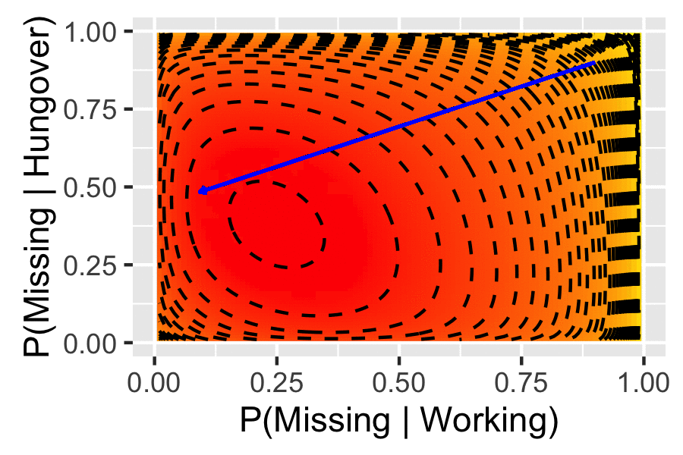
Multi-dimensional gradient descent

Slide 37
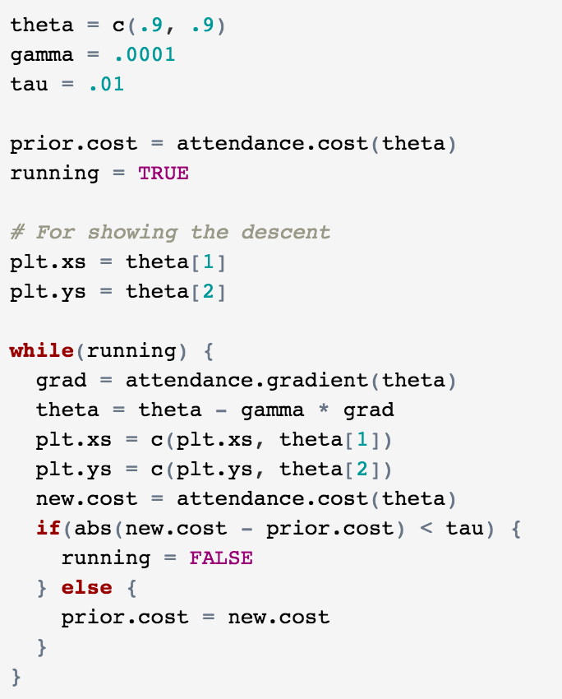
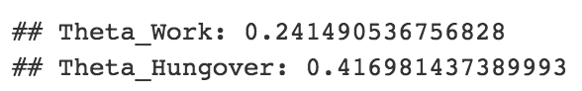
Multi-dimensional gradient descent
θ_{work} = 0.3
θ_{hungover} = 0.4

Slide 38
Differentiable functions
Differentiable: A function is differentiable if there exists a function that provides the gradient at every allowable value of its parameters

Slide 39
Implementation
Language | Single-var | Multi-var
R | optimize | optim
Python* | minimize_scalar | minimize
Matlab | fmindbnd | fminsearch
*: Python optimization functions require the “scipy” package
The implementations of optimization use more advanced algorithms than discussed here. See the notes for further details!

Slide 40
Optimization for Machine Learning

Slide 41
Optimization for machine learning
Stochastic gradient descent
Regularization
Sparse coding
Momentum

Slide 42
Stochastic gradient descent
What happens when the cost function is expensive?
>14 million images!
You want to fit your model to the entire dataset… but computing the entire cost function thousands of times would take forever!

Slide 43
Stochastic gradient descent
If your cost function is decomposable into costs from each individual observation, you can approximate the gradient by calculating the cost on a random subset of the data

Slide 44
Stochastic gradient descent
Stochastic gradient descent: Performing gradient descent iteratively using subsets of the full data set to calculate the cost function

Slide 45
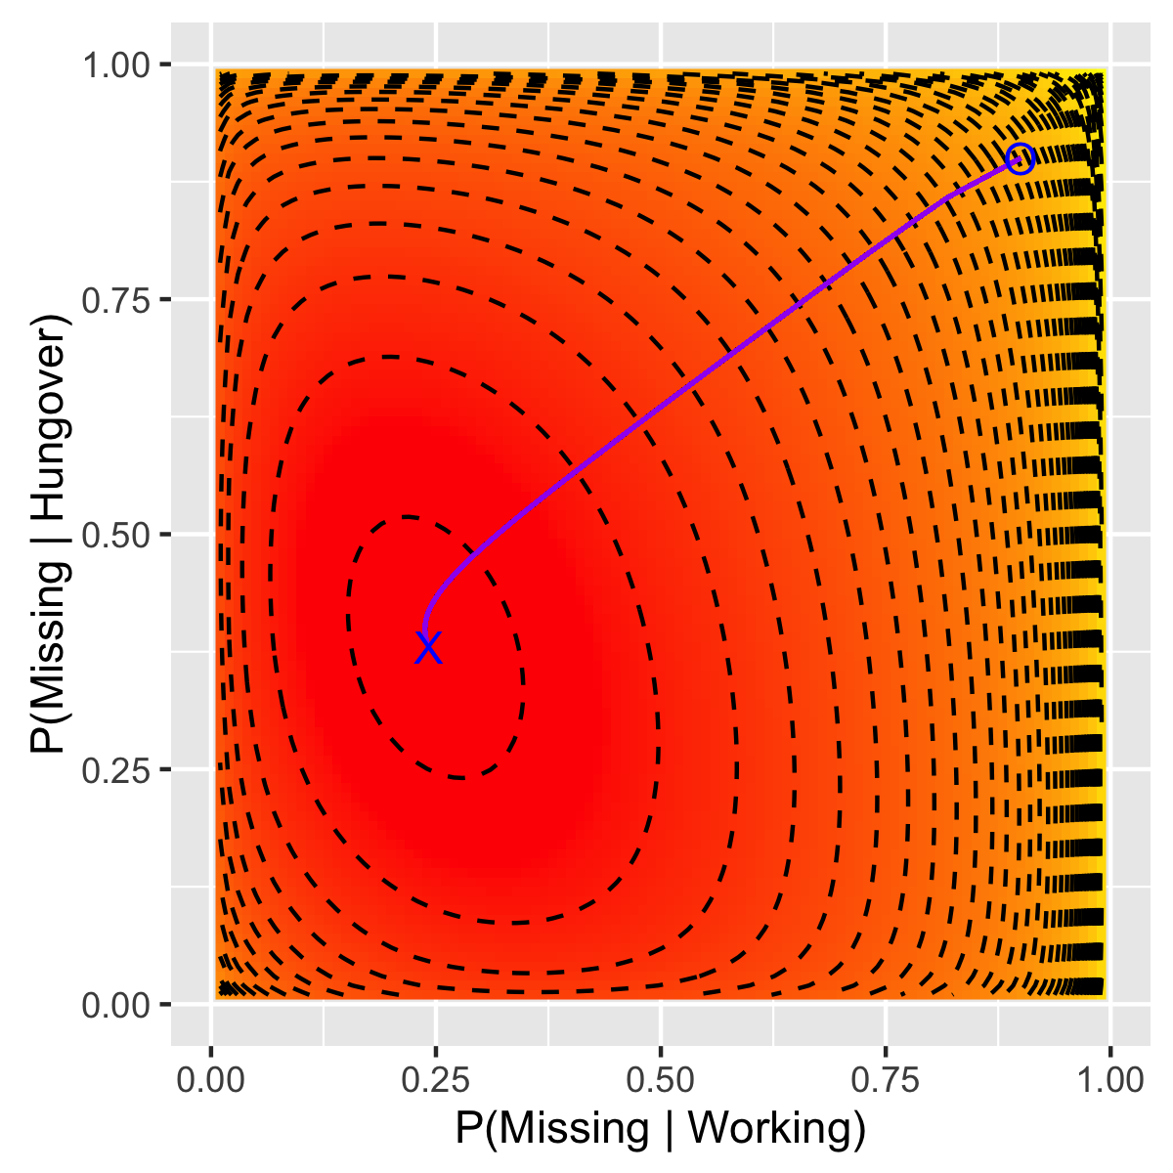
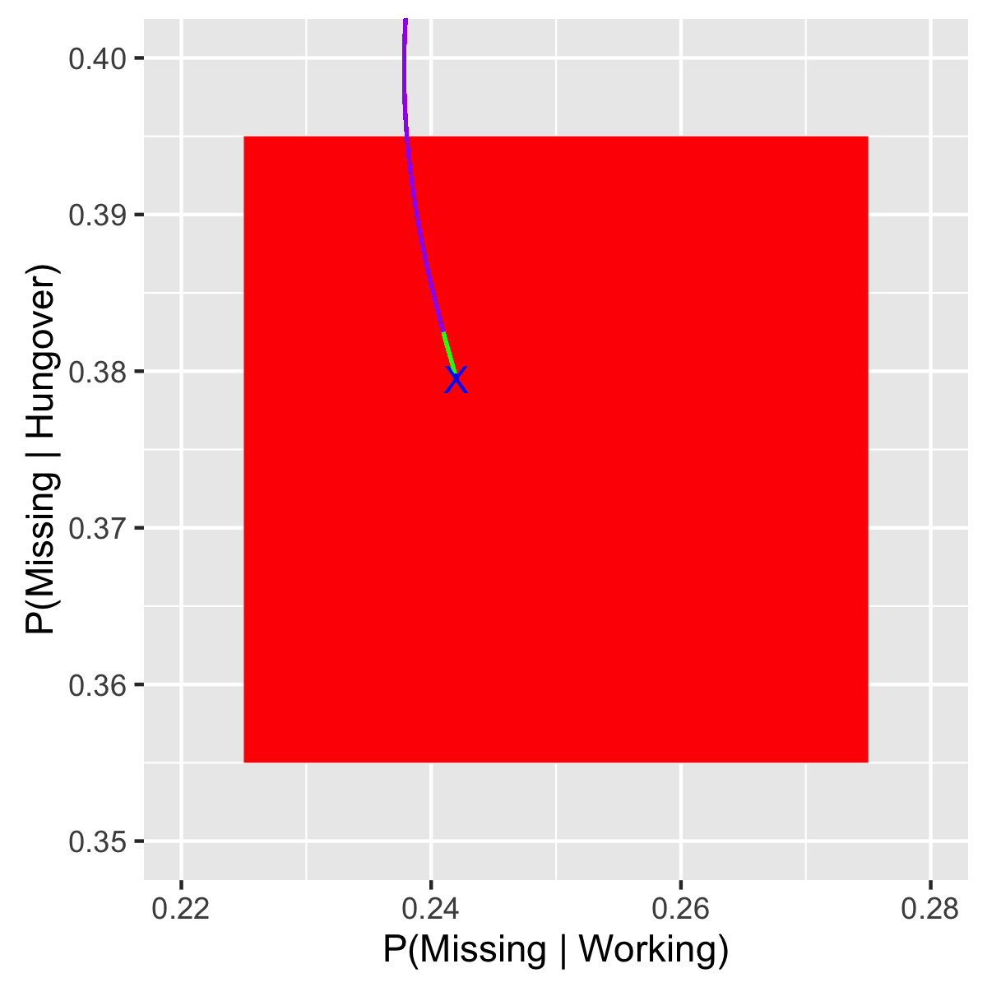
Stochastic gradient descent

Slide 46
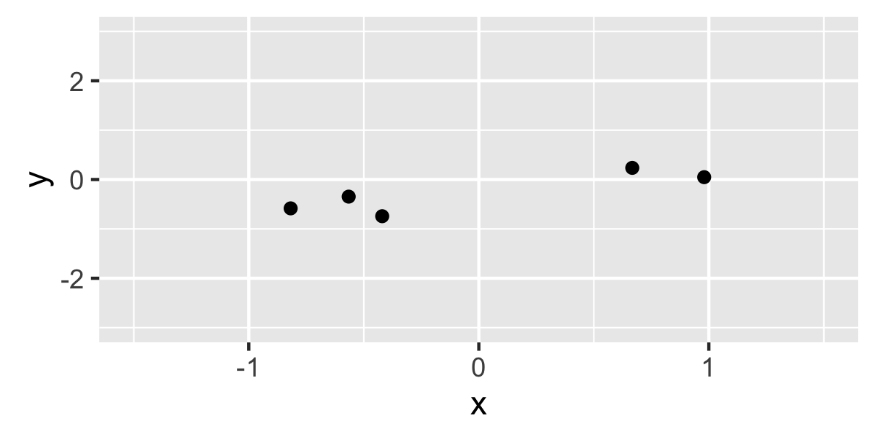
Regularization
Polynomial machine:

Slide 47
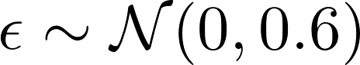
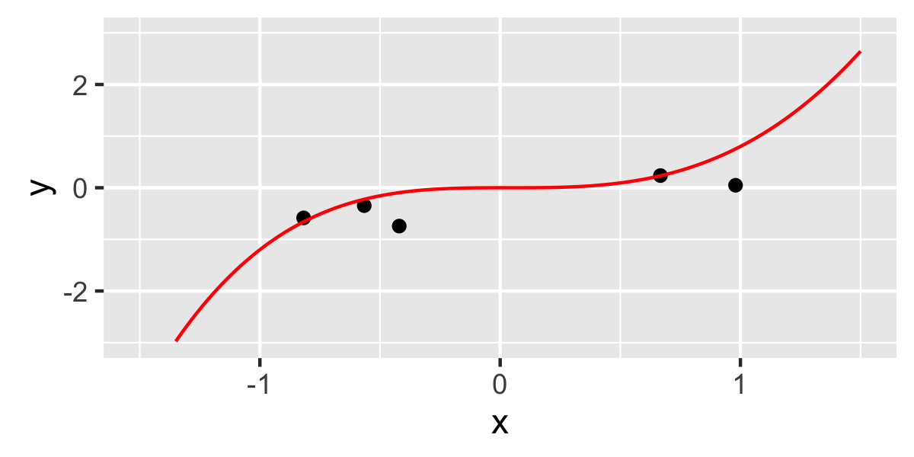
Regularization
Polynomial machine:

Slide 48
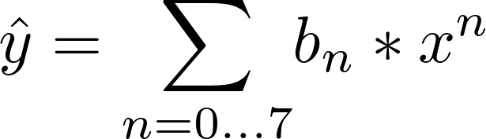
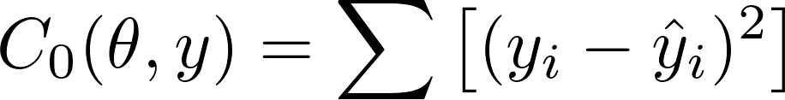
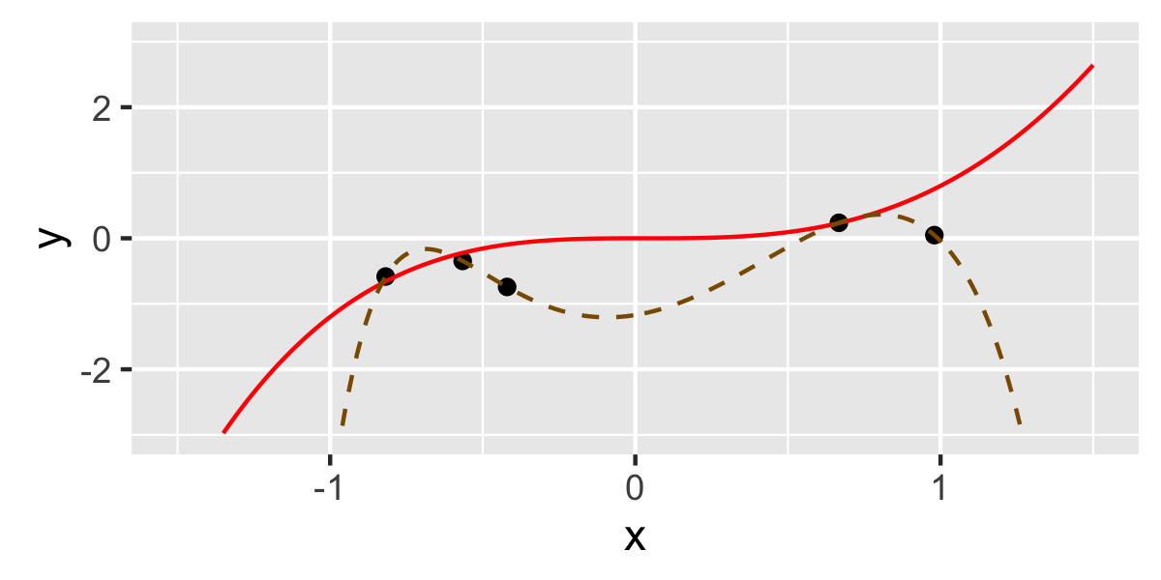
Regularization

Slide 49
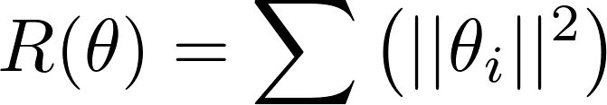
Regularization
Regularization: Imposing an additional cost that is related to the magnitude of the parameters
Strength of regularization
Regularization term – e.g., L₂:

Slide 50
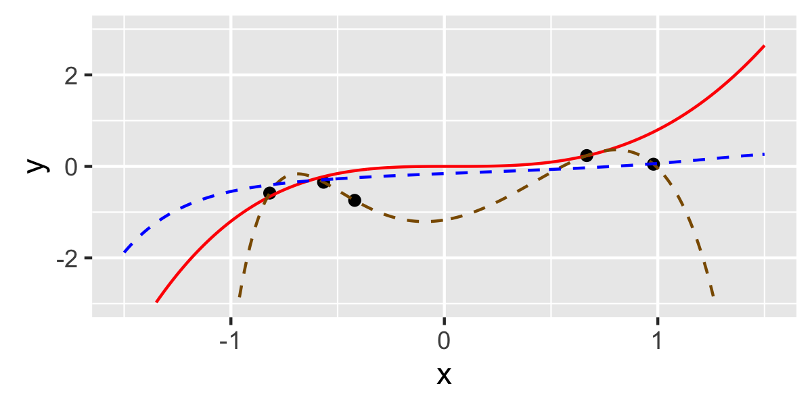
Regularization

Slide 51
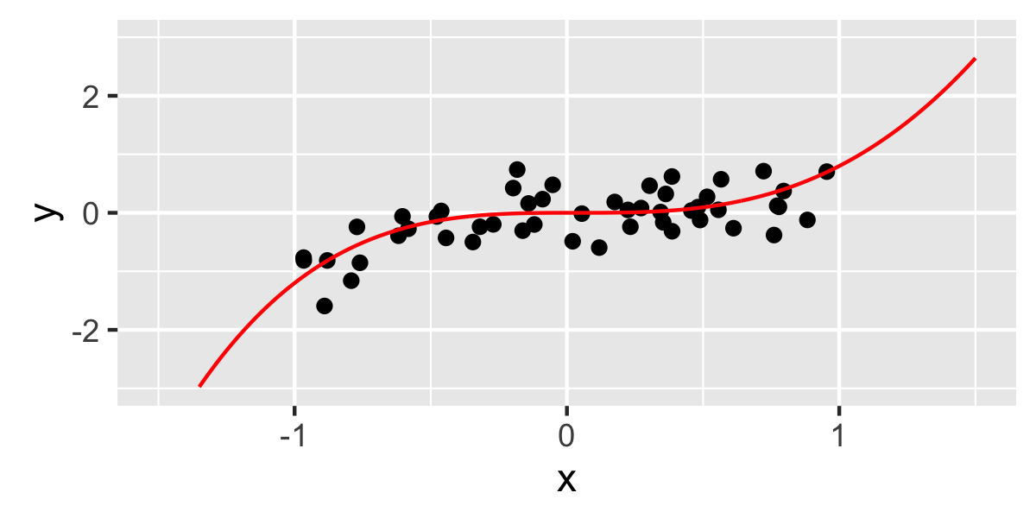
Regularization

Slide 52
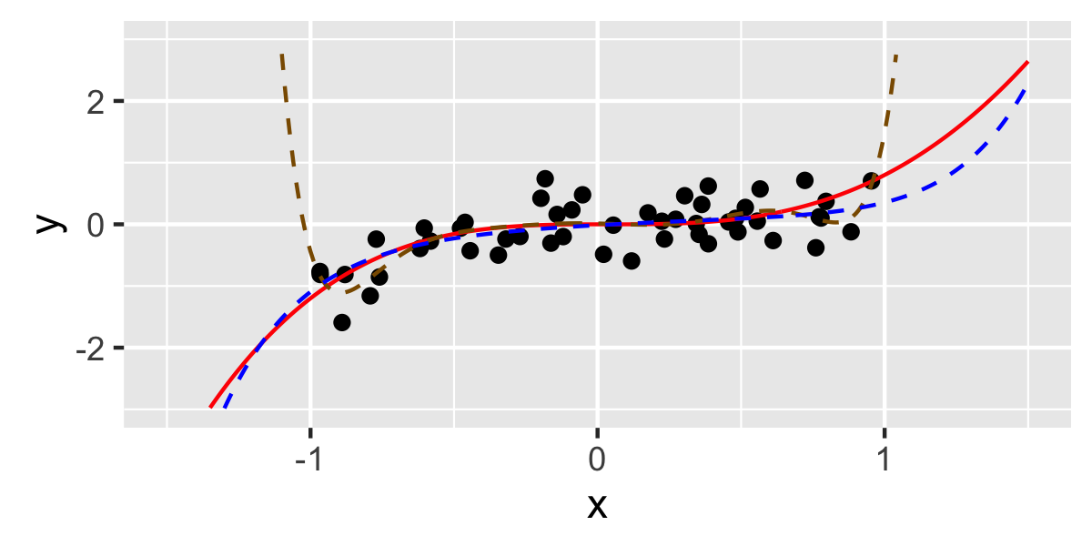
Regularization

Slide 53
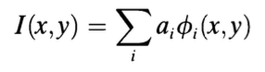
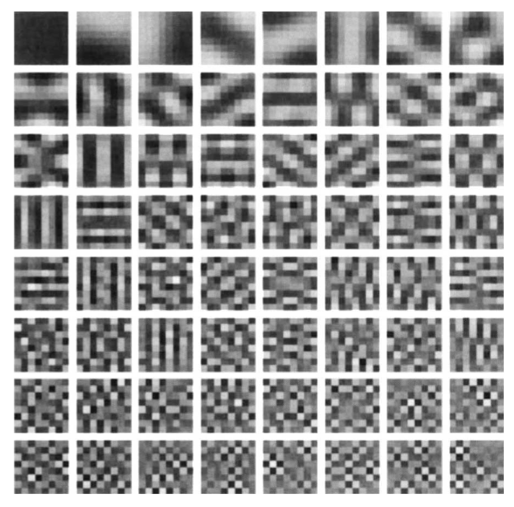
Sparse coding
This lets you recreate all natural images very well
But each image requires contributions from every basis image
Inefficient if:
Cost of activation (neural spiking)
Composition of features
Olshousen & Fields (1996)

Slide 54
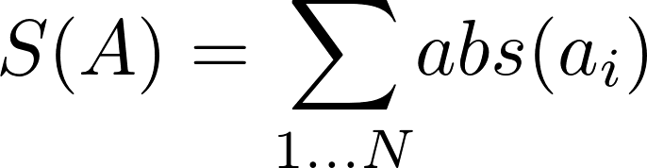
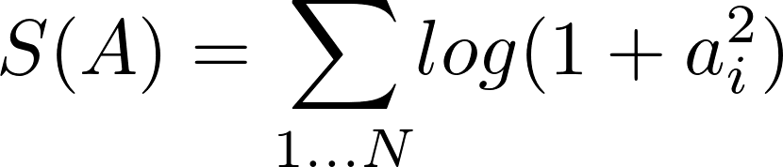
Sparse coding
Sparse coding: Imposing an additional cost that is related to the magnitude of activated units
L₁ sparsity
Log-penalty

Slide 55
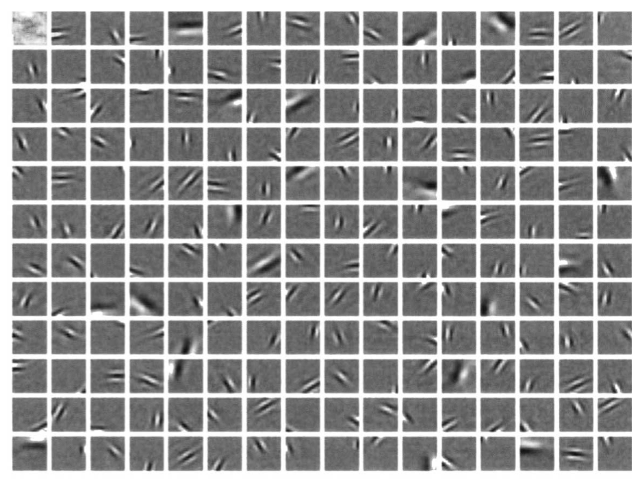
Sparse coding
Olshousen & Fields (1996)
Notes:
Cost is sum square pixel distance + log-sparsity

Slide 56
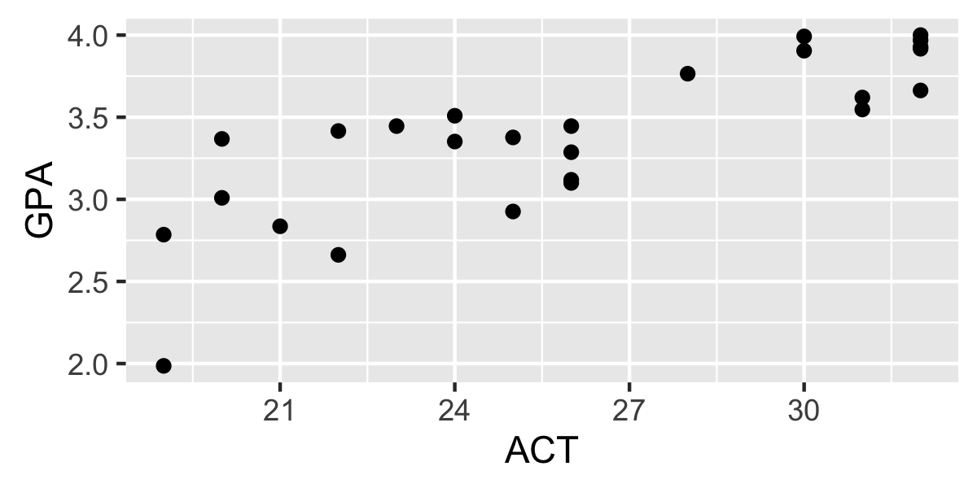
Momentum
Can we predict college GPA from ACT scores?
http://www.calvin.edu/~stob/data/actgpanona.csv

Slide 57

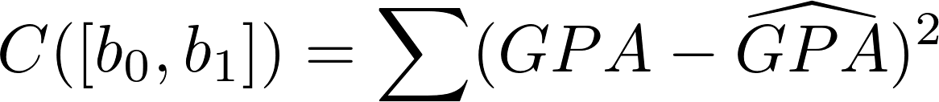
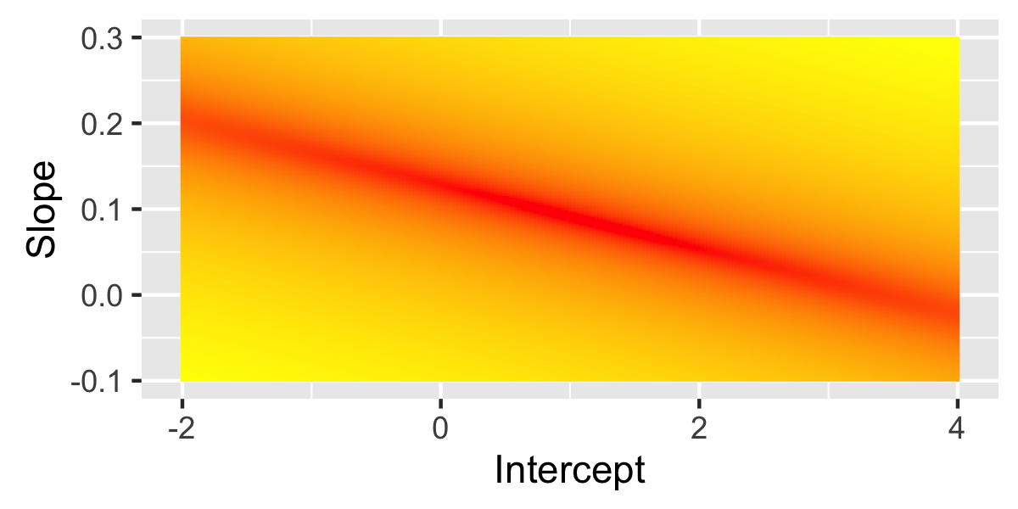
Momentum

Slide 58
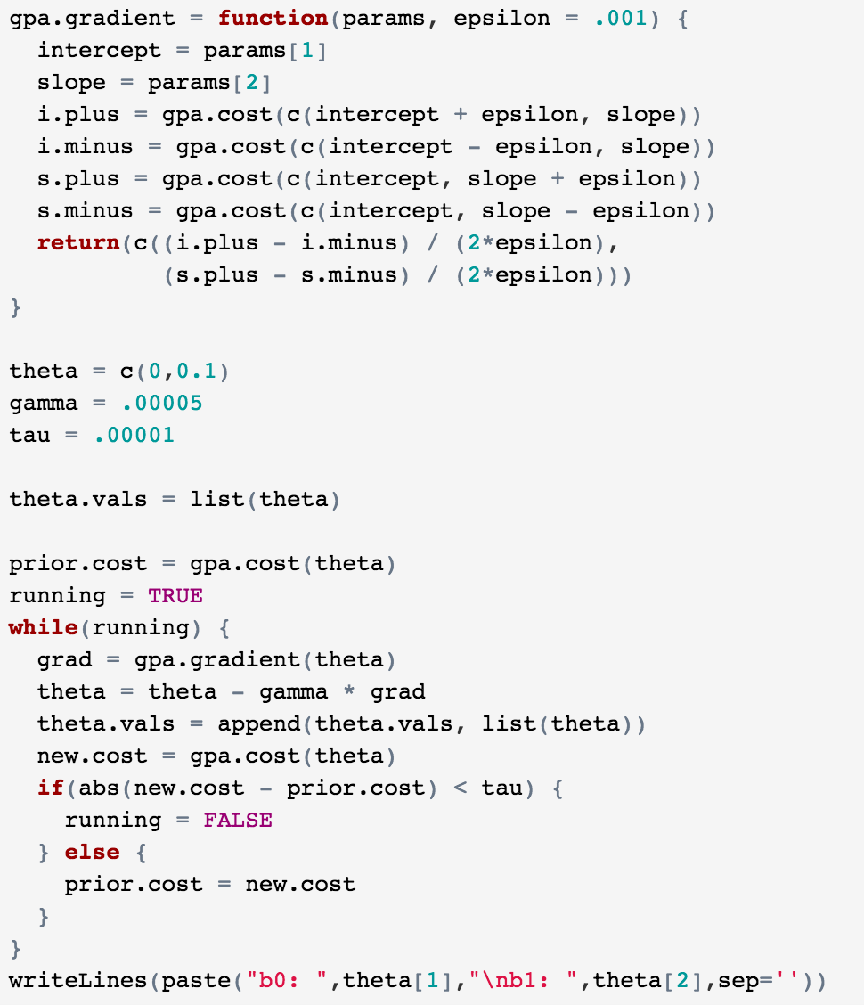
Momentum
Gradient descent
b₀ = 0.807
b₁ = 0.098
Takes 17,665 iterations!
?
b₀ = 1.113
b₁ = 0.087
Linear regression

Slide 59
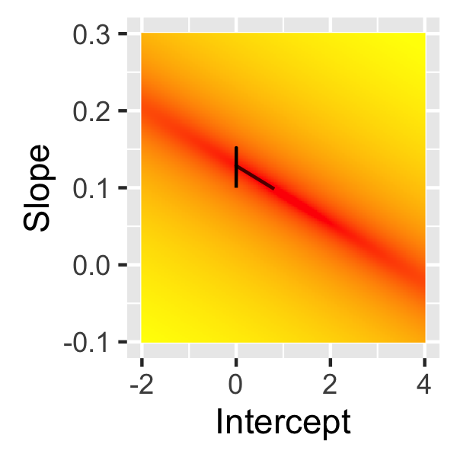
Momentum

Slide 60
Momentum
Momentum: Modifying gradient descent such that your next step is a combination of the gradient and the previous step
Gradient contribution
Momentum contribution

Slide 61
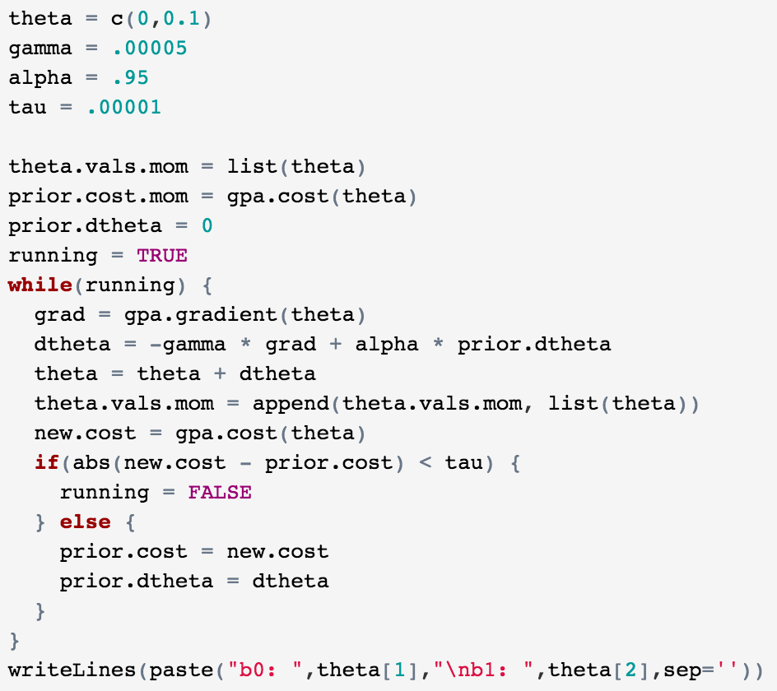
Momentum
Gradient descent
Gradient descent + momentum
b₀ = 0.807
b₁ = 0.098
N = 17,665
b₀ = 1.045
b₁ = 0.090
N = 1,884
b₀ = 1.113
b₁ = 0.087
Linear regression

Slide 62
Summary

Slide 63
Important terms
Likelihood
Maximum likelihood estimate
Cost function
Gradient
Gradient descent
Global / local minima
Convex / non-convex functions
Differentiable functions
Stochastic gradient descent
Regularization
Sparse coding
Momentum

Slide 64
Questions?

